Slide 1


Software Engineering TEAM 4.
Presenter: Kim Woo Kyung
Notes:
Hello, everyone.
This is Team 4, and I will introduce our product --- named Picket.

Slide 2
CONTENTS
Idea background
Project Overview
Development
Expectation
Notes:
Contents are going to be,
First, the motivation of our product,
then moving on to our project overview with prototype,
Third, which tools are we going to use,
Finally, our expectation.

Slide 3


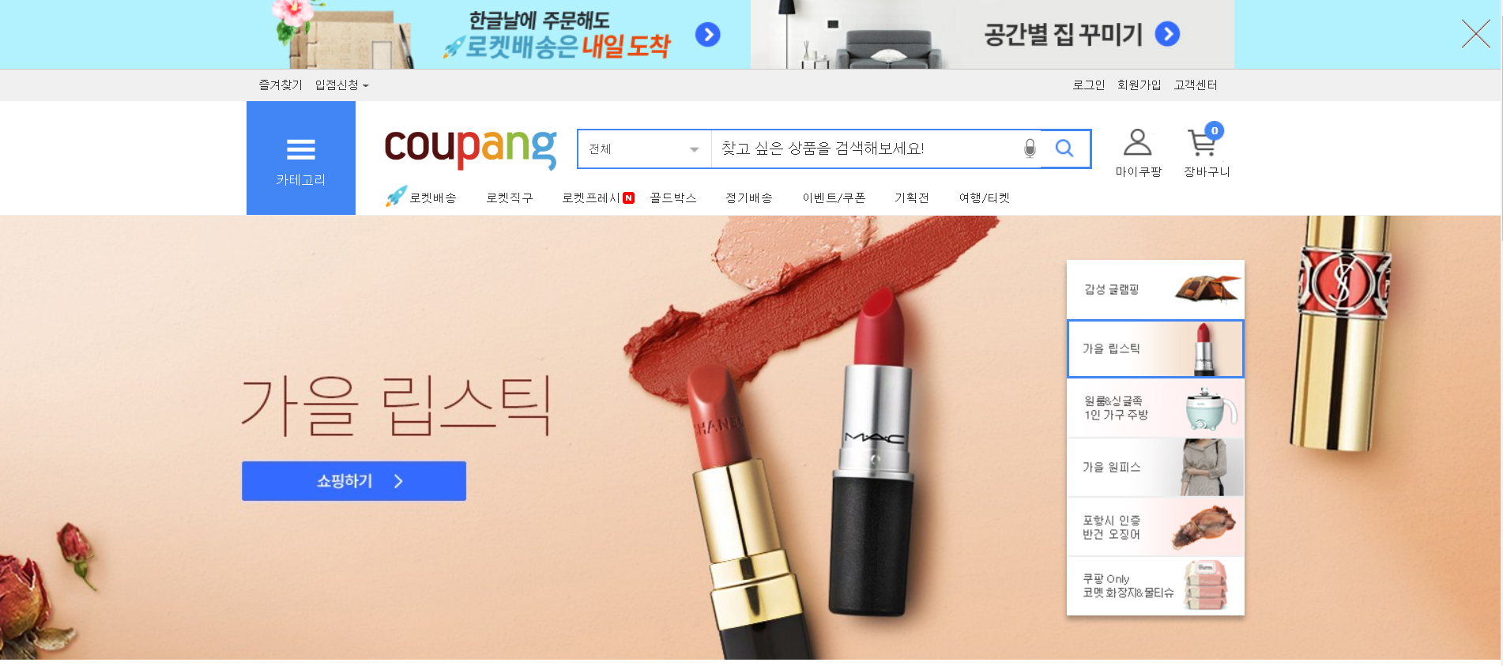
Inconvenient
Web Shopping
hundreds of shopping mall sites,
needs multiple accounts,
careful customers .
Notes:
Nowadays, web shopping are made in variety of products,
books, cosmetics, clothes, foods, electronics, and many other things.
(And there are more online shopping malls sites than offline malls.)
But the thing is web shopping is still inconvenient.
Customers nowadays are very carefu, they does not use a single site, sometimes they want to compare same products on different web sites,
they want similar products on different brands, so they have to open dozens of tabs,
then they have to make accounts for every sites,
and then they put the items in different cart, what we call 장바구니.
like it’s very inconvenient.

Slide 4


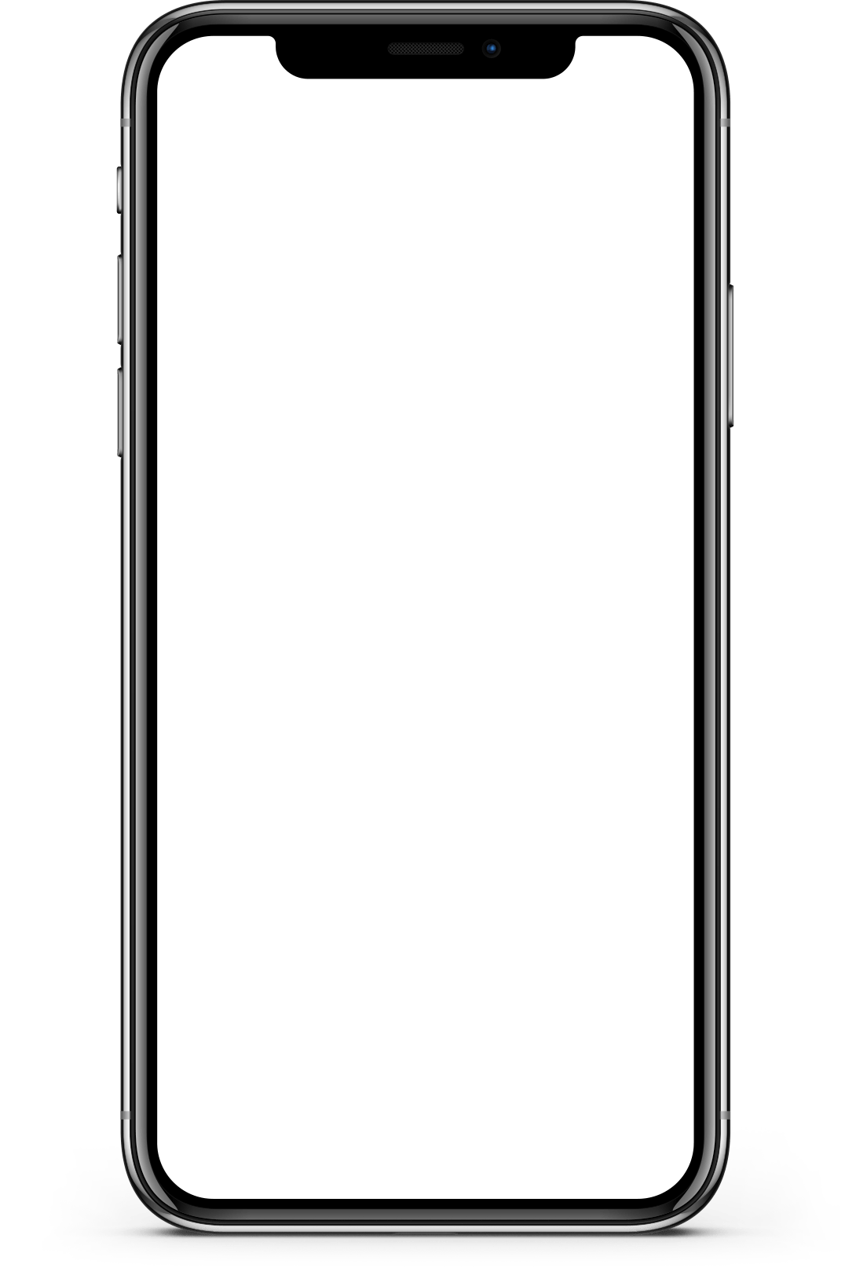
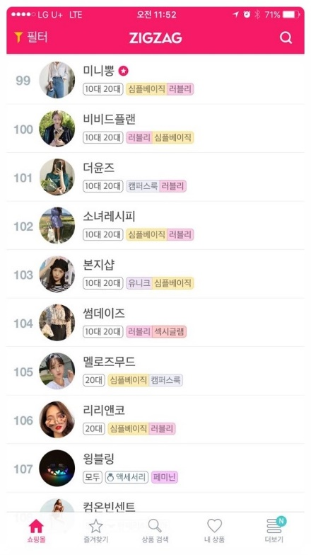
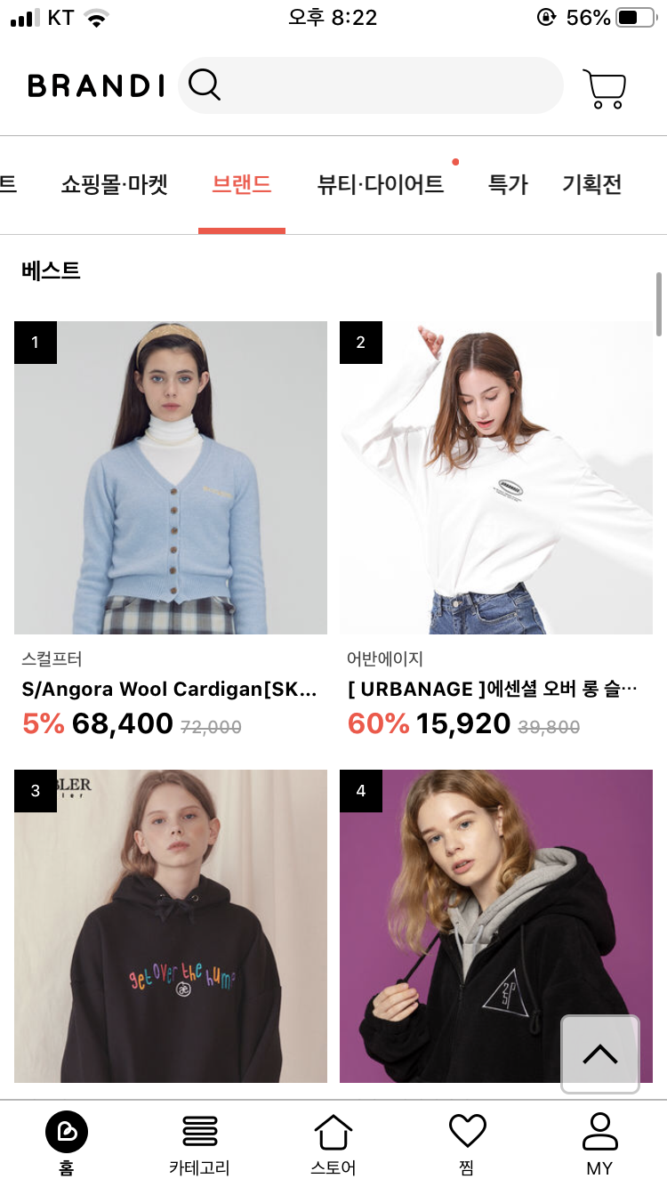
Related Services
Mobile application based
integrated shopping service.
Notes:
To solve this problem,
there are integrated shopping service, for mobile applications.
For example, ZIGZAG and BRANDI.
They gather shopping malls on the same screen, so that customer do not have to go in every single site.
But, these services only offer few brands that have made contract.
Customers want any brands and any sites to be in a single screen.
And, there is no this kind of service for the WEB.

Slide 5
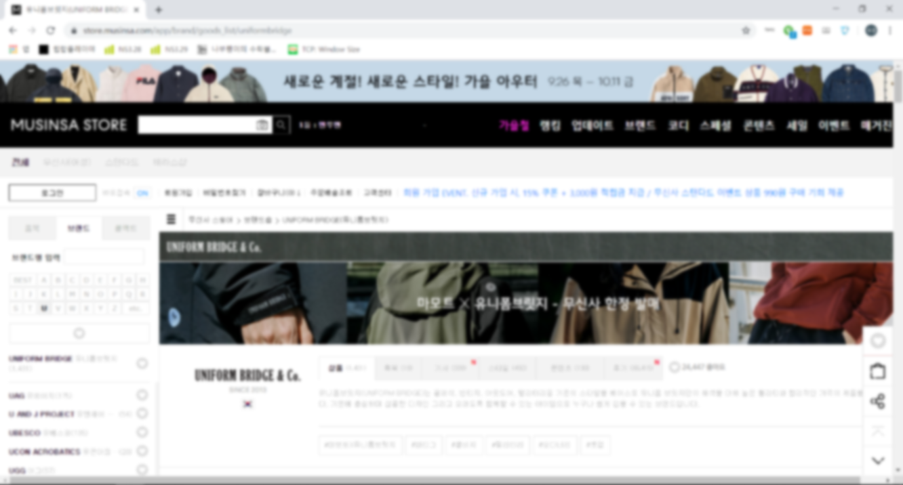
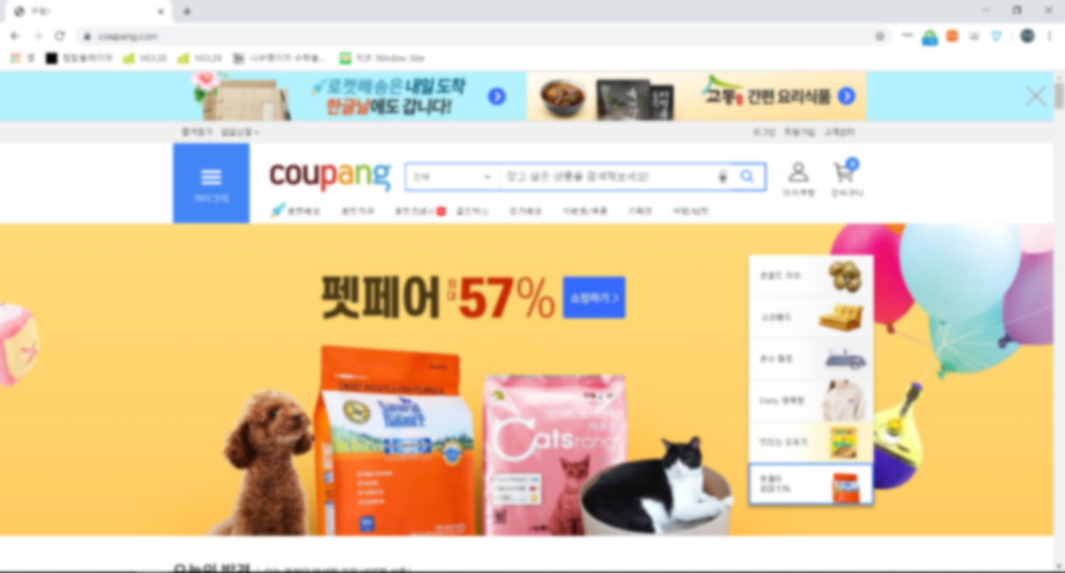
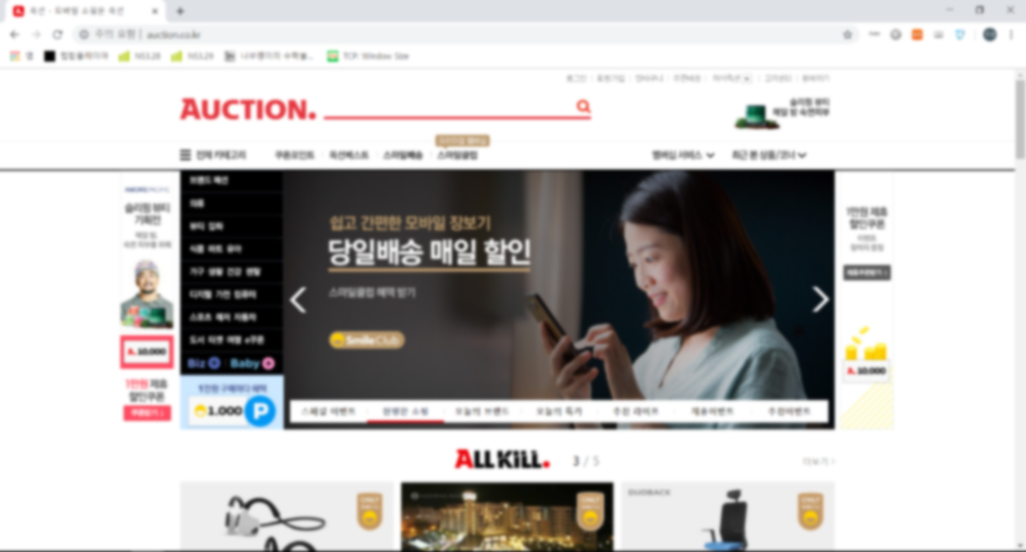
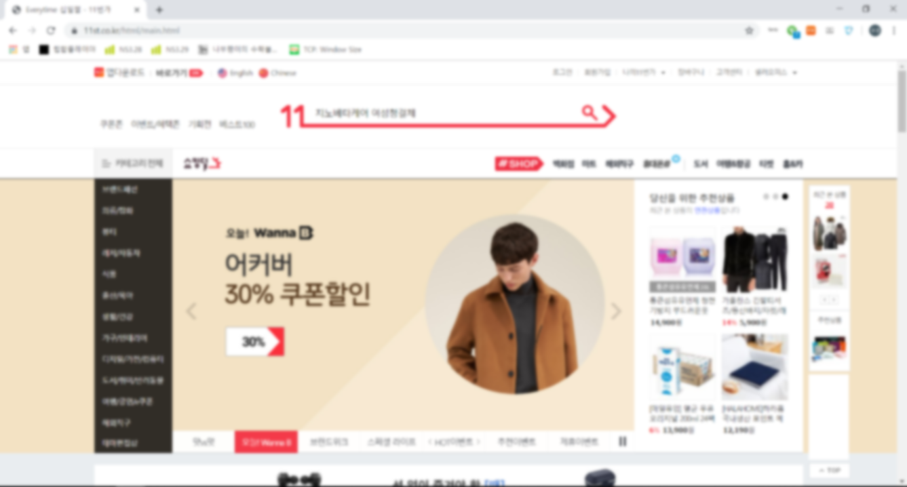

‘PICK T’
Notes:
So, we propose PICKET.

Slide 6


What is ‘PICKET’ ?
+
PICK
BASKET
Notes:
Then What is PICKET And Why PICKET.
The origin of the PICKET is came from the word ‘PICK’ and ‘BASKET’.
Customers picket the products which are in many different sites,
and put them in a single basket.

Slide 7



Why ‘PICKET’ ?
CART
Pick the shopping items and fill in the basket.
Analysis
Offer black and white reviews and find the reasons
Classify
Classify shopping items by site, and sort reviews by items.
Notes:
We offer three major functions.
First, Customers pick the items and put them in the basket.
This is the basic & main functionality that we are aiming to.
Second, PICKET analysis the reviews and offer black and white reviews with the reasons.
In this part we are going to use machine learning skill let PICKET to classify the reviews and their reasons.
Third, PICKET will classify the items by sites in order to achieve simplicity and convenience.

Slide 8
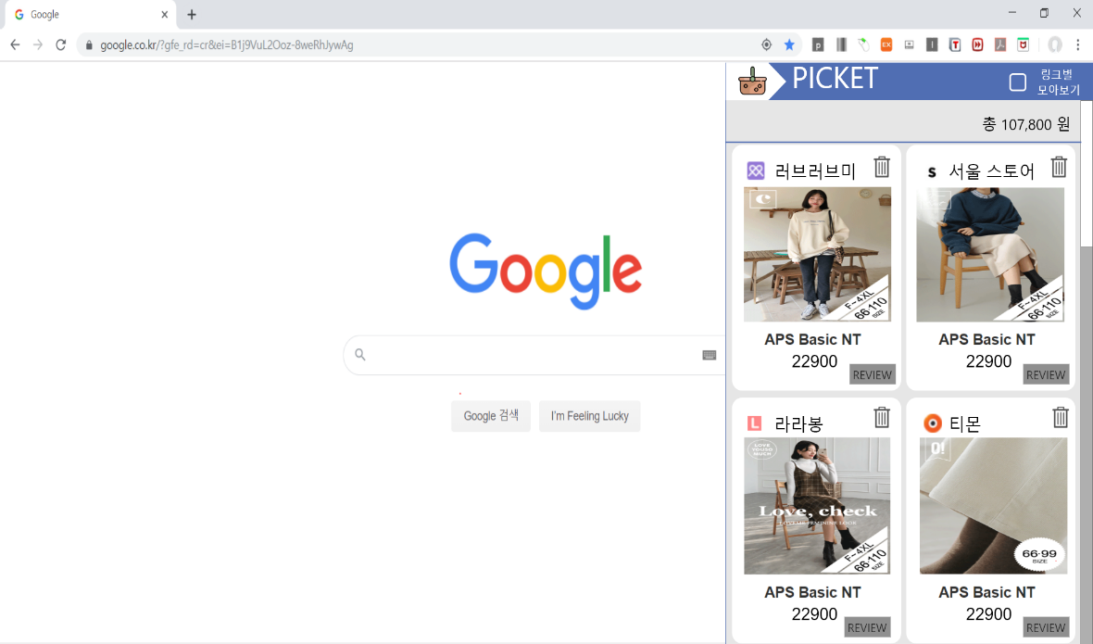
Design Concept
Notes:
This is the prototype of our system,
PICKET will based on the Chrome,
and we are going to make the button on the chrome menu bar,
when customers click the button,
the service will be shown to the customers like this picture.

Slide 9
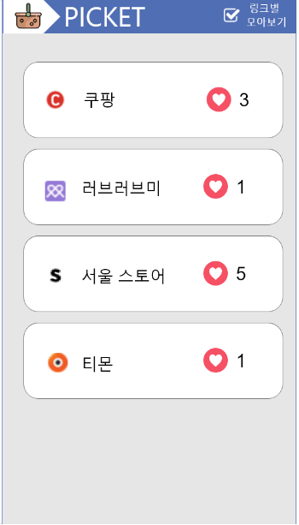
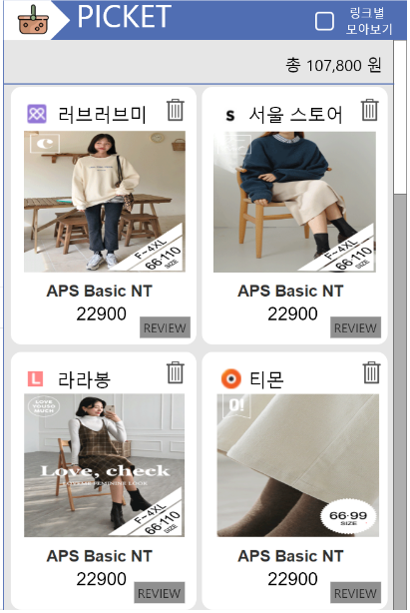
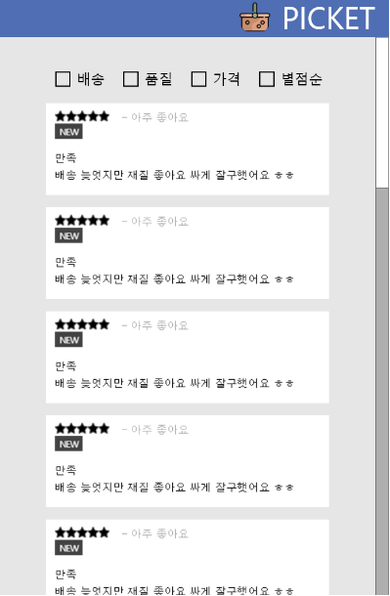
Classify
Cart
Review
Notes:
PICKET will show classified menu, the shopping cart with items form different web shopping malls, and the review for each items.
In review tab, we will classify the good and bad reviews, with the reasons like bad quality, cost-efficiency and the ratio.
Again, this is only for the first draft, the detailed design will be changed.

Slide 10
System
Frontend
Backend
Web Application Server (WAS)
Database
Parser
Classifier
Review Analysis System
System Structure
Notes:
This is our overview of System Structure.
In backend, there are going to be database with the registered sites, and the parser, classifier and review analysis system.

Slide 11


Frontend
_ Ju Hye won
Chrome Extension
UIKit
Make Integration
Program to Browser
Frontend Framework
Fast development
Powerful web interface
Notes:
For the frontend, we are going to use Chrome Extension, with the frame work.
And Ju Hey won will be charged on this part.

Slide 12




Backend
_Kim Woo Kyung, Sung Chang Min, Moon Jae Wan
Tensorflow
MySQL
Database
Management System
Machine Learning
Platform
Comprehensive interface
Flexible ecosystem of tools
Node.js
JavaScript-based
Server Framework
Parse 5
JavaScript-based
HTML Parsing Tool
Notes:
For the backed, we will use node.js for the server,
mysql for database management,
tensorflow for machine learning
and parse5 for parsing tool.

Slide 13



Expectation
01
02
03
CONVENIENCE
It can solve the inconvenience of shopping around various sites.
SIMPLICITY
It can provide simplicity in the form of extension of web browser.
FUNCTIONALITY
It provides a variety of functions, such as adding a product to a shopping cart or sorting reviews.
Notes:
Our Goal is to achieve these three major functionality.

Slide 14
Thank you for listening!

